Slide 1




Project
SkillScope
Fyp - 1 Presentation - 2024
Members
Ali Salman (Group Leader)
Hassan Ali Zain
Syed Rizwan Hussain
Hasnain Hafeez

Slide 2


Our Supervisors
Miss Tahniyat Mirza
Miss Tahniyat Mirza brings a wealth of experience in Web Development, covering both frontend and backend technologies. Her expertise in API Integration will guide us in seamlessly connecting with various data sources to power our recommendation engine. With her support, we aim to build a robust and user-friendly platform that aligns with industry standards.
Miss Sumera Hashmi
Miss Sumeera Hashmi specializes in Artificial Intelligence and Data Algorithms. Her guidance will be crucial in developing intelligent algorithms that can accurately analyze student skills and job data. She will help us leverage machine learning techniques to provide personalized career recommendations, ensuring our platform delivers meaningful insights to users.

Slide 3


Probelm Statement
Challenges Faced by IT Students
Lack of Clear Guidance on In-Demand Skills
Despite access to resources, 40% of IT students report confusion about which tech skills to prioritize, impacting their career decisions (LinkedIn Learning)
Mismatch Between Academia and Industry Needs
A study by McKinsey reveals that only 42% of employers believe recent graduates are equipped with the necessary skills, highlighting a significant skill gap.
Barriers in Career Planning
Overwhelming Information Overload
According to IBM, 64% of students struggle with filtering online resources to identify relevant skills, leading to a lack of focused career planning.
Lack of Real-Time Job Market Insights
Deloitte reports that 62% of job seekers are unaware of the latest job market trends, causing missed opportunities for high-demand roles

Slide 4
Probelm Statement
Need for Personalized Career Guidance
Unclear Skill Combinations for Tech Roles
A report by Harvard Business Review found that 70% of graduates are unaware of essential skill combinations for specialized tech positions.
Growing Demand for Tailored Career Solutions
Gartner predicts that by 2026, 75% of universities will adopt AI-powered career advisory systems to align student skills with industry needs, emphasizing the demand for innovative platforms.
Impact on Student Employability
Global EdTech Market
Many IT graduates enter the job market feeling unprepared, which negatively impacts their confidence during applications and interviews, reducing their chances of securing desired roles.
Widening Skill Gap in Tech
As technology evolves rapidly, the gap between the skills taught in academia and those required by industry continues to grow. This creates a pressing need for students to proactively align their learning with current market demands.

Slide 5


Business Objectives
Personalized Career Guidance
Empower IT students with tailored career guidance to match their skills and interests, helping them choose the most suitable career paths and improve their chances of success in the tech industry.
Real-Time Job Market Insights
Leverage up-to-date job market data to provide insights into trending skills, job roles, and salary ranges, ensuring students have access to the latest industry information for informed career planning.
Bridging the Academia-Industry Gap
Align academic learning with real-world industry demands by offering customized skill recommendations, bridging the gap between what students learn in school and what employers are seeking in the job market.
Continuous Skill Development
Encourage students to stay ahead by adopting a mindset of continuous learning, providing insights into emerging technologies and high-demand skills, thus fostering adaptability in a rapidly evolving tech landscape.
Data-Driven Career Decision-Making
Support strategic career planning through data-driven recommendations, enabling students to make informed decisions about the best tech stacks, certifications, and career paths to pursue based on current job trends.

Slide 6




Project Scope
Target Audience
SkillScope is a specialized career guidance platform tailored for IT students, including those studying Computer Science, Data Science, Artificial Intelligence, Cybersecurity, and Software Engineering. It focuses on helping students align their academic skills with industry needs to enhance job readiness.
Core Objective
Provides a comprehensive set of features to deliver personalized career guidance, including skill-building recommendations, real-time job market insights, and curated career paths. The platform aims to empower students to make informed career decisions and improve their employability.
Value Proposition
Aims to bridge the persistent gap between academic education and industry expectations by offering targeted insights and recommendations. The platform is designed to improve the alignment of students' learning with current market trends, helping them transition smoothly into the tech job market.

Slide 7
Core Objectives
Providing Real-Time Career Insights
Leverages real-time job market data to provide IT students with actionable insights on trending skills, available job roles, and salary benchmarks. This ensures that students are informed of current industry demands, enabling them to align their learning accordingly.
Personalized Career Path Recommendations
Uses AI-powered algorithms to offer career paths tailored to individual student profiles, skills, and interests. This personalized approach helps students identify optimal career trajectories, from entry-level positions to specialized roles in fields like data engineering and software development.
Enhancing Employability
Aims to improve student employability by providing data-driven skill-building recommendations. By identifying high-demand skill combinations, the platform enables students to focus their learning efforts on areas that will maximize their job market readiness.

Slide 8
Key Features and Functionalities
Real-Time Data Integration
Integrates APIs from platforms like JSearch and LinkedIn to pull up-to-date job postings, skill trends, and industry requirements. This ensures that the platform provides accurate and current career guidance, reflecting the latest market dynamics
AI-Driven Skill Analysis
Utilizes machine learning algorithms to analyze student profiles and suggest tailored skills, certifications, and learning resources. The AI engine takes into account the student's existing competencies and career aspirations, enhancing the relevance of recommendations.
Interactive Career Pathway Visualizations
Offers a dynamic dashboard that visualizes career progressions, from internships to senior roles. This feature helps students plan their career moves strategically by understanding the skills and certifications required for advancement in their chosen field.

Slide 9
Scope Boundaries and Limitations
Targeted Geographic Coverage
Initially focuses on job markets in key regions like the US, UK, Canada, and Australia. These regions are selected for their high demand in tech roles, with plans to expand into other geographic areas based on user demand and data availability.
Technical Skill Emphasis
Concentrates on high-demand technical skills, such as Python, Cloud Computing, and Web Development, rather than non-technical skills. The platform prioritizes skills that are critical for success in IT and tech-related fields, ensuring students are industry-ready.
Dependency on External Data Sources
Relies on external job data APIs to provide real-time insights. The platform’s effectiveness is contingent upon the availability and quality of data from these third-party sources, which may pose limitations if data access is restricted or interrupted.

Slide 10








Project Methodology Overview
Our project adopts the Waterfall methodology, a structured, linear approach to development that ensures clarity, control, and quality. This methodology is ideal for well-defined projects like SkillAlignr, where each phase is completed before the next begins, reducing risks and ensuring alignment with project goals.
Requirements Analysis
System Design
Gathered detailed requirements to align platform features with the needs of IT students.
Focused on identifying skills demand, job roles, and market trends.
Ensured stakeholder alignment for a successful project kickoff.
Designed a robust system architecture with user-centric UI mockups.
Created database schemas to handle real-time job market data and skill recommendations.
Developed wireframes to map out user flows and platform functionalities.
Development and Coding
Testing and Deployment
Implemented features using Python for backend algorithms and React for the frontend.
Integrated APIs to provide real-time insights into job postings and in-demand skills.
Ensured scalability and performance optimization through efficient coding practices.
Conducted unit tests and integration tests to ensure platform stability.
User Acceptance Testing (UAT) with IT students to gather feedback and refine the platform.
Deployed on cloud servers for scalability, with ongoing maintenance for continuous improvement.

Slide 11




Benefits & Key Deliverables of the Waterfall Methodology
The Waterfall methodology provides a structured and efficient approach to project management, especially for projects like Skill Scope. It ensures a step-by-step progression, minimizes risks, and guarantees that each phase is completed with quality before moving on to the next. This approach is critical in delivering a reliable and user-focused career guidance platform.
Benefits
Key Deliverables by Phase
Clear Milestone Tracking: Ensures each project phase is completed with precision before moving forward.
Reduced Development Risks: By tackling one phase at a time, potential issues are identified early, avoiding costly mistakes.
Comprehensive Requirements Analysis: Gather detailed student needs and skill demands to align platform features.
Fully Functional Platform: Deliver a tested, user-friendly platform that offers personalized career insights and job trends.
Continuous Improvement & Feedback
Resource Management & Efficiency
User Testing & Feedback: Engage students for hands-on testing, refining the platform based on real feedback.
Performance Monitoring & Updates: Continuously track platform performance to implement iterative updates and enhancements.
Optimized Resource Allocation: Ensure efficient use of team resources, reducing time and cost overruns.
Documentation & Traceability: Maintain thorough documentation to enhance transparency and ease future maintenance.

Slide 12
Project Schedule
App and Website Design
(Days 1-60)
Database & Data Collection
(Days 61-120)
Machine Learning Model
(Days 121-170)
Backend Development & Integration
(Days 171-200)
Quality
Assurance and
Feedback
(Days 200-240)
Develop UI/UX, Authentication System, Dashboard Layout
Implement Landing Page, Signup/Sign-in functionality
Define User Schema, API Integration for Data Collection
Data Analysis for Job Market Trends
Building a recommendation model for job role predictions based on skills and experience.
Fine-tuning hyperparameters and conducting performance evaluation to ensure accuracy.
Developing career field prediction algorithms and job role suggestion engines.
Connecting backend services with the frontend dashboard for real-time user interactions.
Perform unit and integration tests for system stability.
Gather feedback to refine features and improve usability.

Slide 13
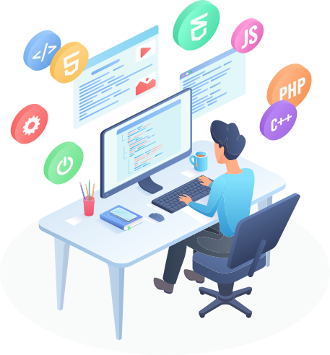
SOFTWARE TOOLS & LIBRARIES
BACKEND & FRONTEND DEVELOPMENT
PROGRAMMING & IDE
Node.js
React
SQL/MongoDB
Rapid API
Python (3.12),
Jupyter,
VS Code
DATA ANALYSIS & VISUALIZATION
DESIGN & TESTING
NumPy
Pandas
Matplotlib
Seaborn
SciPy Toolkit Learn
Figma
Postman
Git
MACHINE LEARNING & NLP
Keras (2.3.1)
TensorFlow
NLTK or SpaCy

Slide 14

HARDWARE REQUIREMENTS
PROCESSOR
GRAPHICS
Modern multi-core (Intel i5/i7, AMD Ryzen 5/7) for smooth performance
Integrated graphics (Intel UHD or AMD Vega) or dedicated GPU (Nvidia GTX) for intensive tasks
RAM
OPERATING SYSTEM AND DISPLAY
Minimum 8 GB
(16 GB recommended )
Windows 10/11, macOS, or Linux based on compatibility
FullHD(1920x1080) resolution for enhanced UI/UX design work
STORAGE
SSD (256 GB or more)

Slide 15
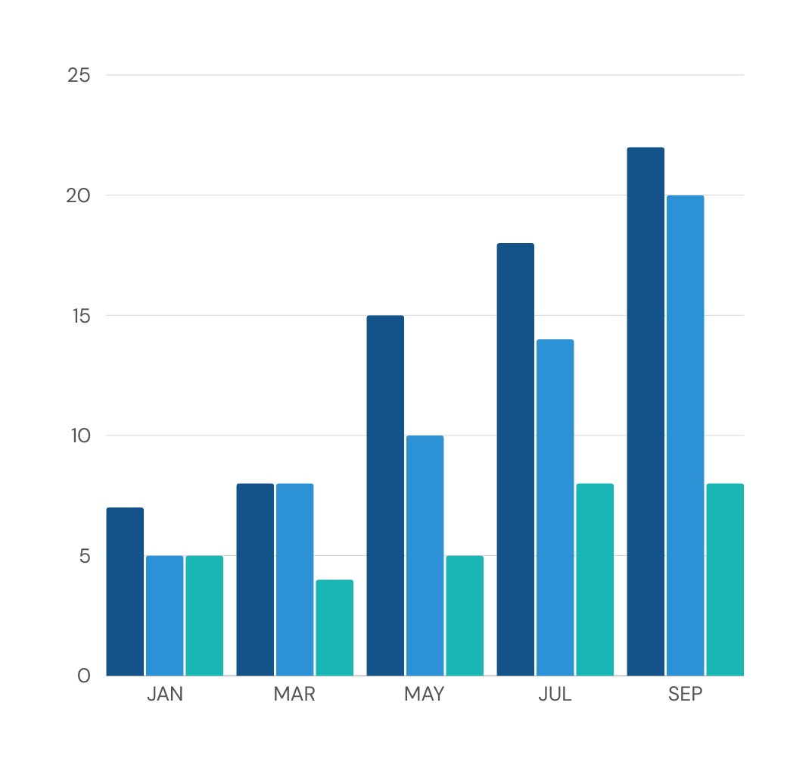
PROJECT BUDGET & COSTING
200K
DEVELOPMENT HOURS
Total Hours: 640 hrs
Rate per Hour: 3,000 PKR
Total Development Cost: 1,920,000 PKR
ADDITIONAL COSTS
Hardware: 15,000 PKR
APIs & External Resources: 30,000 PKR
Other Resources: 25,000 PKR
TOTAL PROJECT COST
Grand Total: 2,010,000 PKR

Slide 16


FYP DELIVERABLES
Phase I
UI Prototype
(FYP1)
Phase 2
Backend Integration & Beta Prototype (FYP2)
Phase 3
Final Product
Planning & Requirements Gathering
Abstract Summary & Project Proposal
UI Design, Prototyping, and Front-End Development
Backend Architecture & Development
Data Model Training & Testing
Full System Integration & Testing
Fully Operational & Deployed Product
User Acceptance Testing (UAT)
Final Documentation & Delivery

Slide 17
Research Foundations & Key References
Impact of Data-Driven Decision Making
Brynjolfsson, E., Hitt, L. M., & Kim, H. H. (2011). Strength in Numbers: How Does Data-Driven Decision-Making Affect Firm Performance? Social Science Research Network. [Available at SSRN].
Leveraging External APIs for Real-Time Data
Johnson, P. & Lee, K. (2022). Analyzing Job Market Trends Using Big Data. Journal of Data Science and Analytics.
Brown, D. (2021). API Integration and Its Impact on Digital Platforms. Tech Innovations Journal.
Career Trends in Information Technology
U.S. Bureau of Labor Statistics. (2020). Occupational Outlook Handbook: Computer and Information Technology Occupations. [Available at BLS].
Smith, J., & Watson, R. (2023). Leveraging Artificial Intelligence for Personalized Career Guidance. International Journal of Career Development.

Slide 18


Summary
Empowering IT Students with Data-Driven Career Guidance
Skill Scope addresses the gap between academic learning and industry needs by providing IT students with real-time insights into high-demand skills and job opportunities. This platform offers tailored recommendations based on data analytics, enabling students to align their skillsets with current market trends, thus enhancing their employability.
Personalized Insights for Informed Career Decisions
By analyzing job postings and tech skill trends, Skill Scope provides personalized career roadmaps. The platform highlights trending technologies like data science, cloud computing, and software development, guiding students towards the most relevant skills and certifications needed for today’s competitive job market
Bridging Academia and Industry for Future Readiness
Our solution empowers students to make strategic career choices by offering up-to-date industry insights. With features such as skill-building suggestions, real-time job data, and career path planning, Skill Scope ensures students are industry-ready, bridging the gap between their academic education and practical job market demands.

Slide 19

Thank You
For Your Attention
Members
Ali Salman (Group Leader)
Hassan Ali Zain
Syed Rizwan Hussain
Hasnain Hafeez

